Slide 1













Slide 2


READING PLUS SUMMER CHALLENGE
THE CHALLENGE:
TO READ DURING THE SUMMER!
You can read on Reading Plus, a physical book, magazine,
or comic - it all counts!

Slide 3
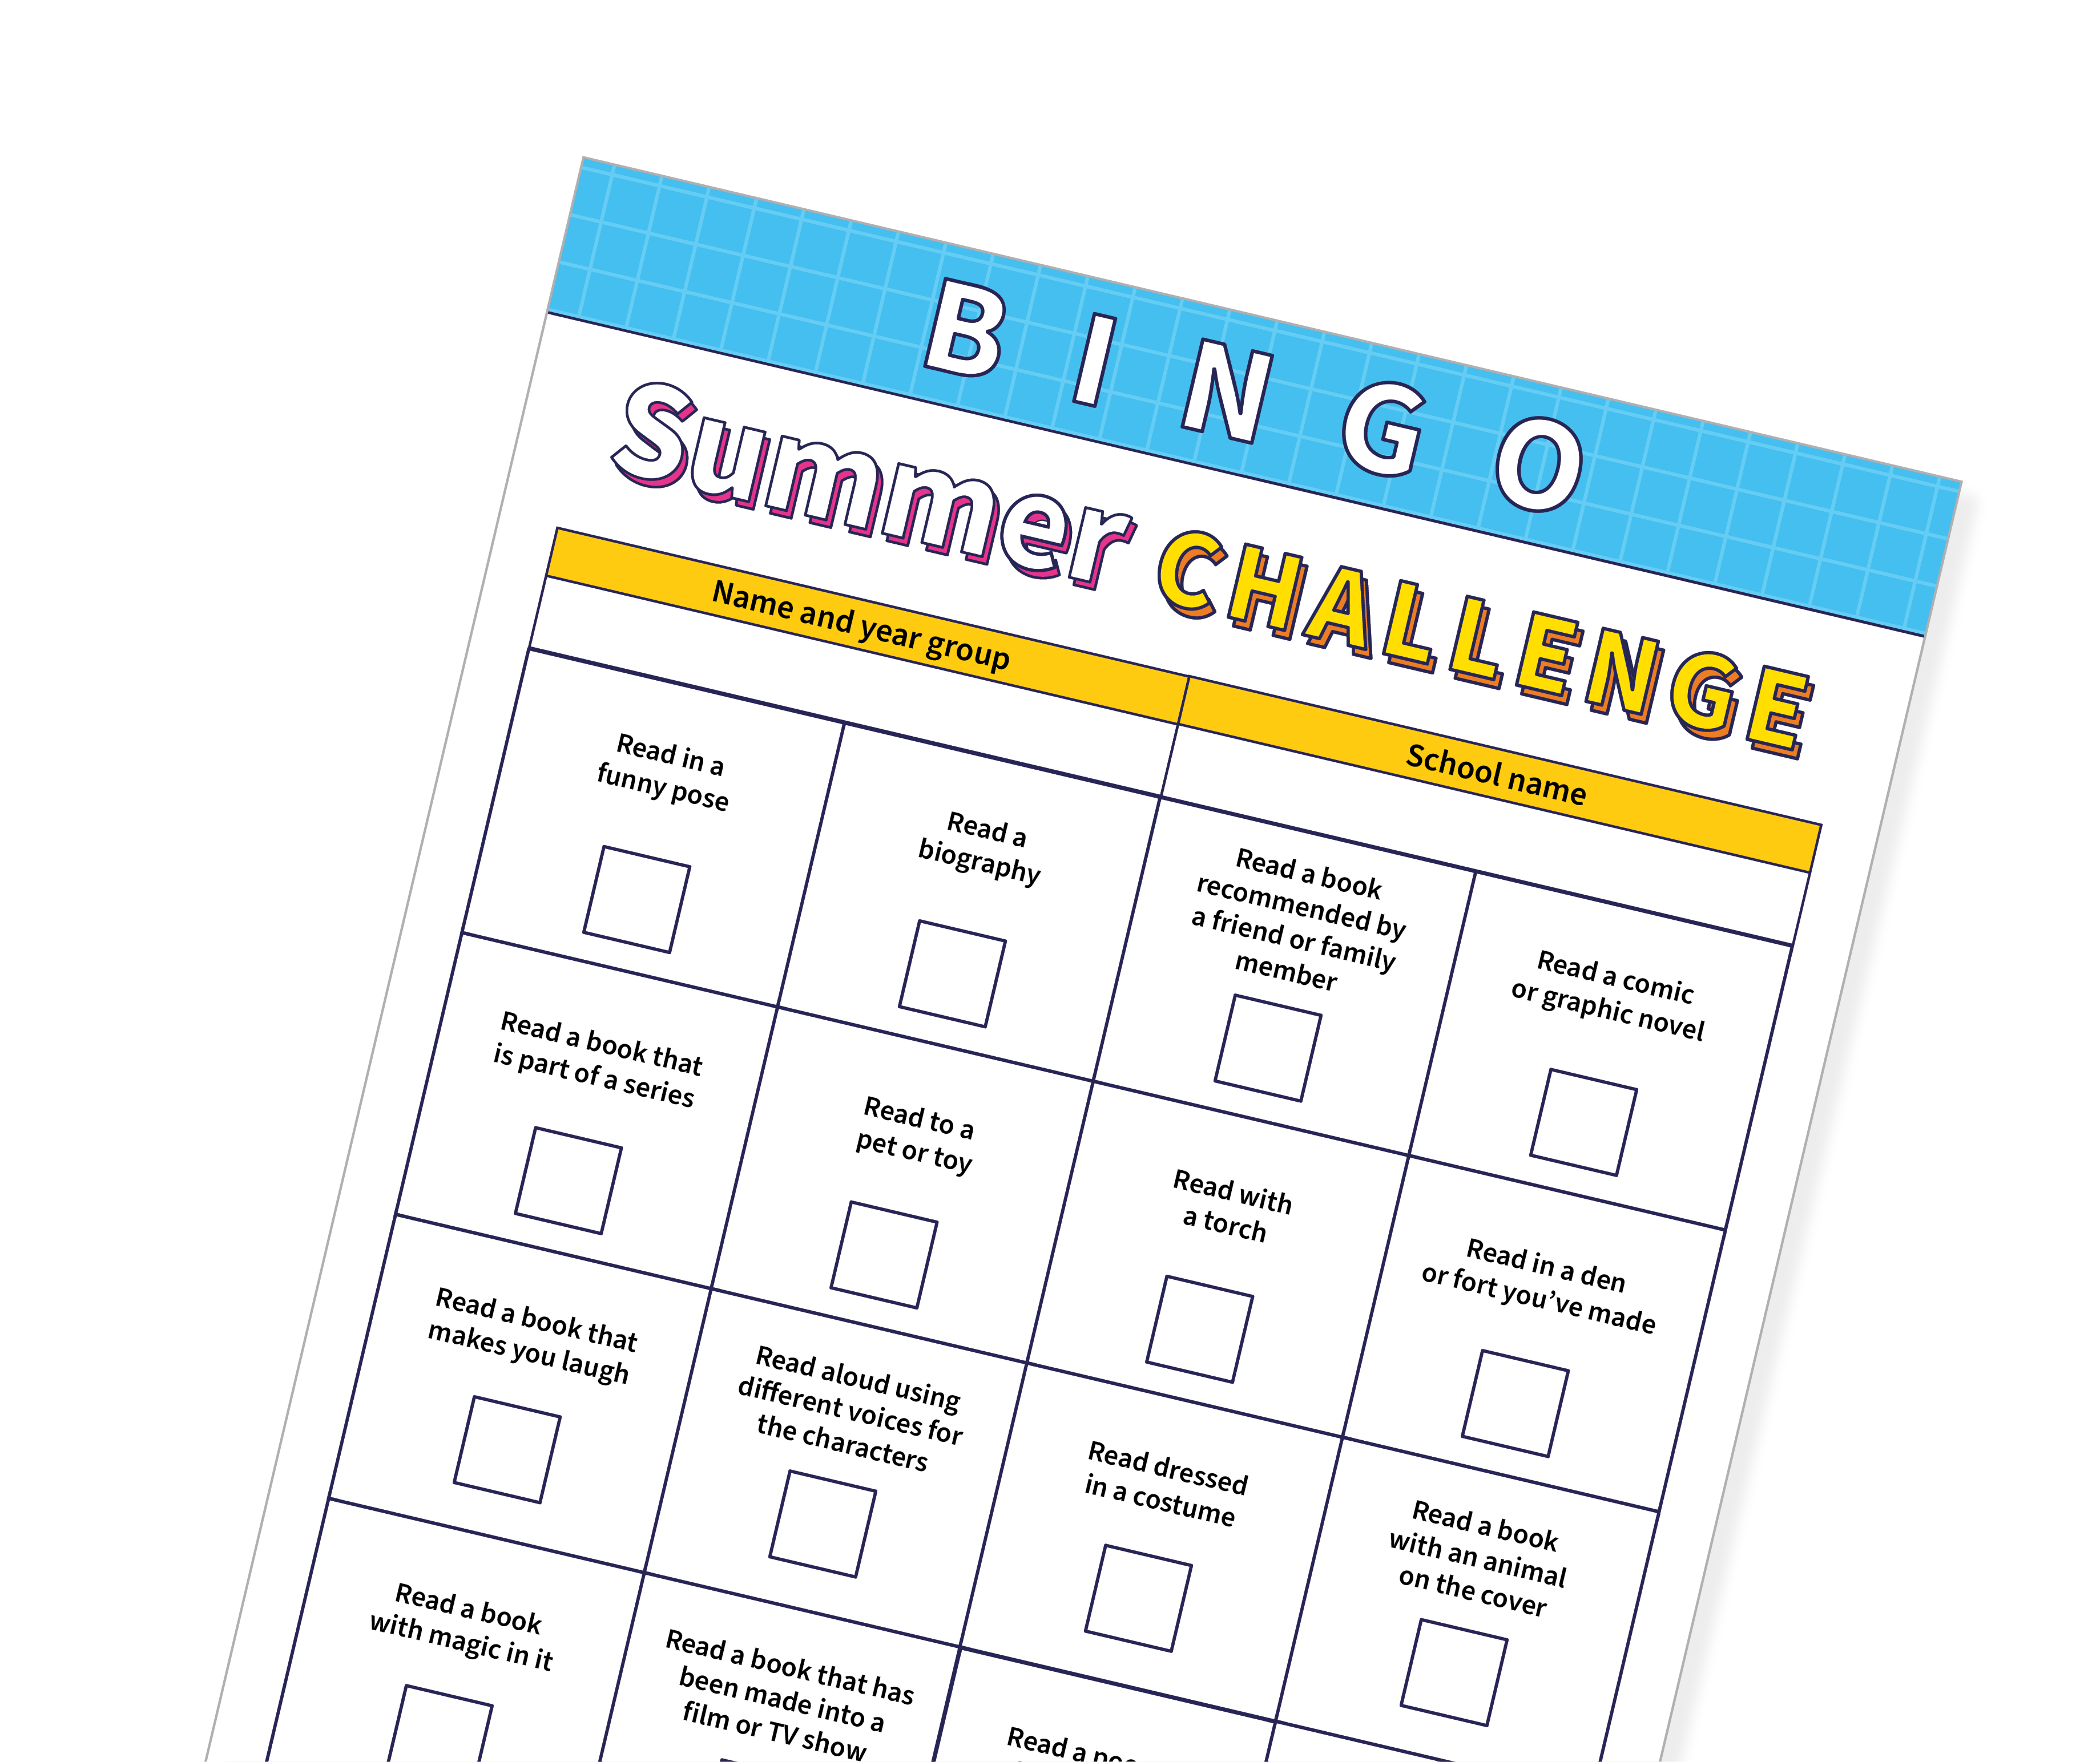

SUMMER CHALLENGE
Using the Bingo Challenge sheet, participate in several mini-reading challenges while testing your bingo skills this summer.
Please return the completed worksheets
to school by the 6th September.
WHAT CAN YOU WIN!
5 winners will be selected to win a
£50 voucher and a personalised certificate.

Slide 4
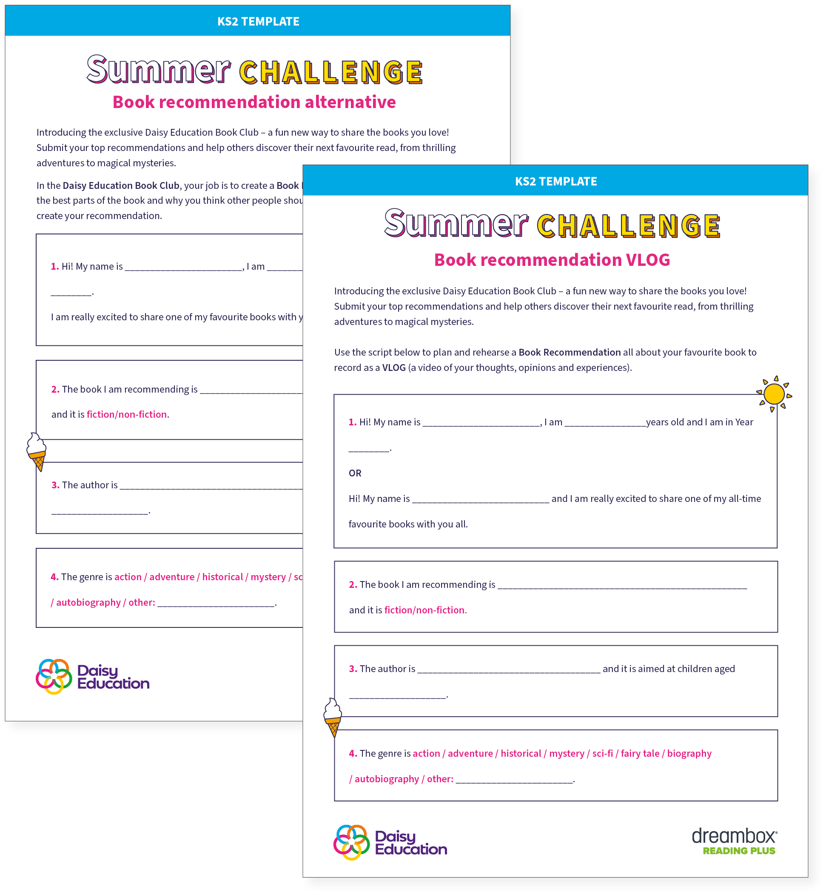
BOOK RECOMENDATION
Have you ever read a book you loved so much that you just had to tell someone else to read it too? You can also take part of the summer challenge by submitting a:
VIDEO BLOG: Practise and record your very own VLOG — that’s a short video where you talk about your thoughts, opinions and experiences linked to the book.
Download the template here
BOOK REVIEW: Write a book recommendation about what makes the book great and why others should read it.
Download the template here
Please return the completed worksheets to school by the 6th September.

Slide 5
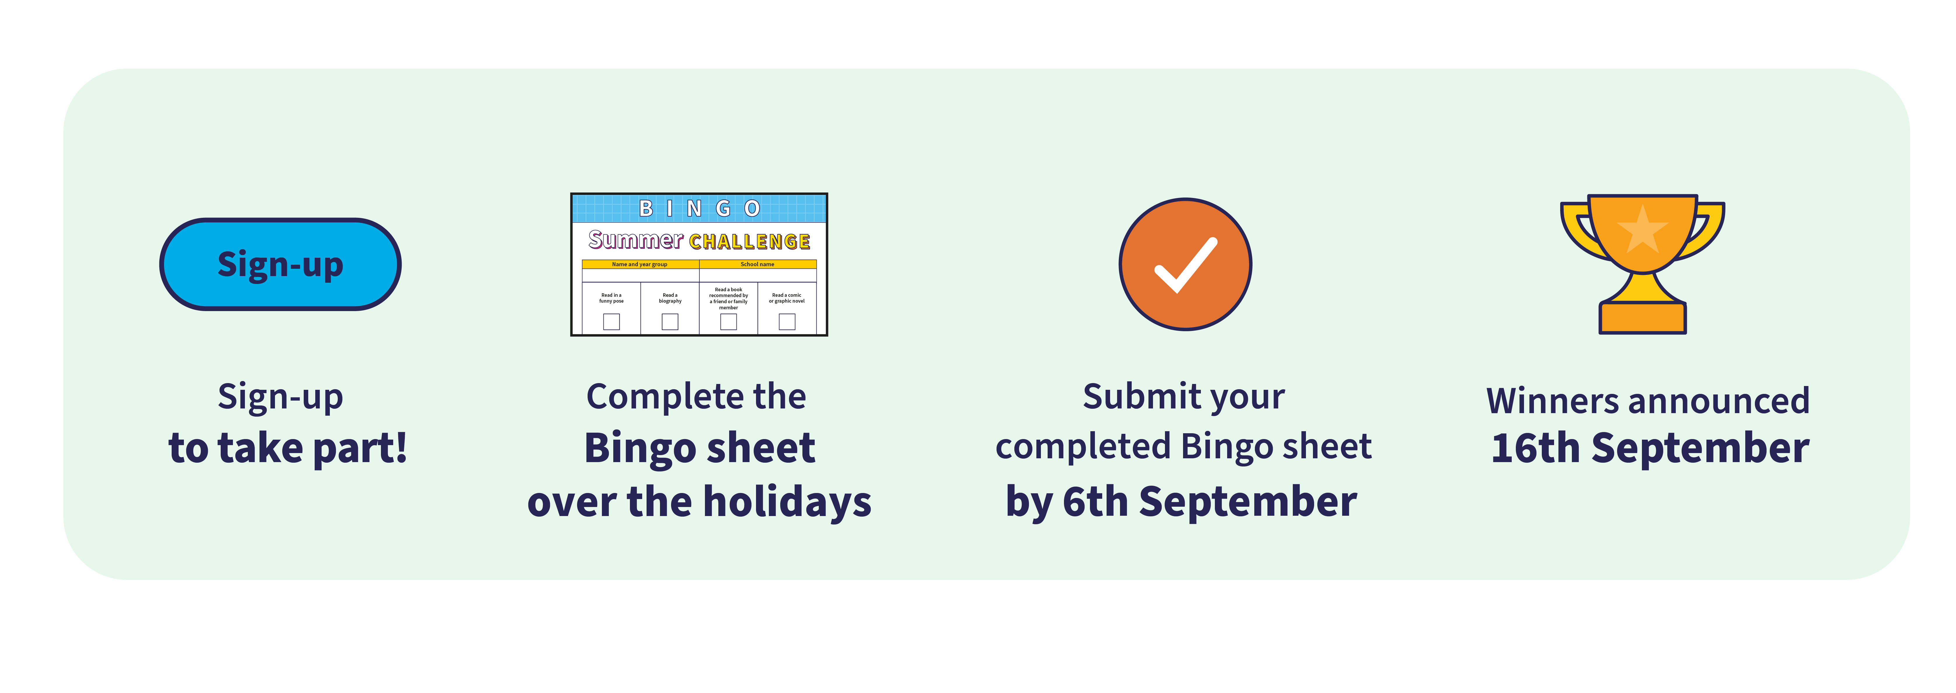


TIMELINE

Slide 6
WHY IS IT IMPORTANT TO READ DURING THE SUMMER
Reading during the summer holidays will:
Give you enjoyment!
Improve your reading confidence and independence
Support your learning for the new school year
Help you retain knowledge and skills learned this year

Slide 7
QUESTIONS?

