Slide 1
Get ready for Launchpad!
For KS1/LKS2 pupils

Slide 2
What is Launchpad?
Launchpad is a series of questions and activities you will complete when you first log in to DreamBox Maths.
It will:
Look like a normal DreamBox Maths lesson – but have more questions and cover a range of topics.
Be longer than a DreamBox Maths lesson - and will last 15-45 minutes.
Find out what you already know in maths, and what you need to learn.
It will not:
Be a test or give you a score.
It is simply for DreamBox Maths to understand where it can help you.
Notes:
Is ‘experience’ still fine to use?

Slide 3
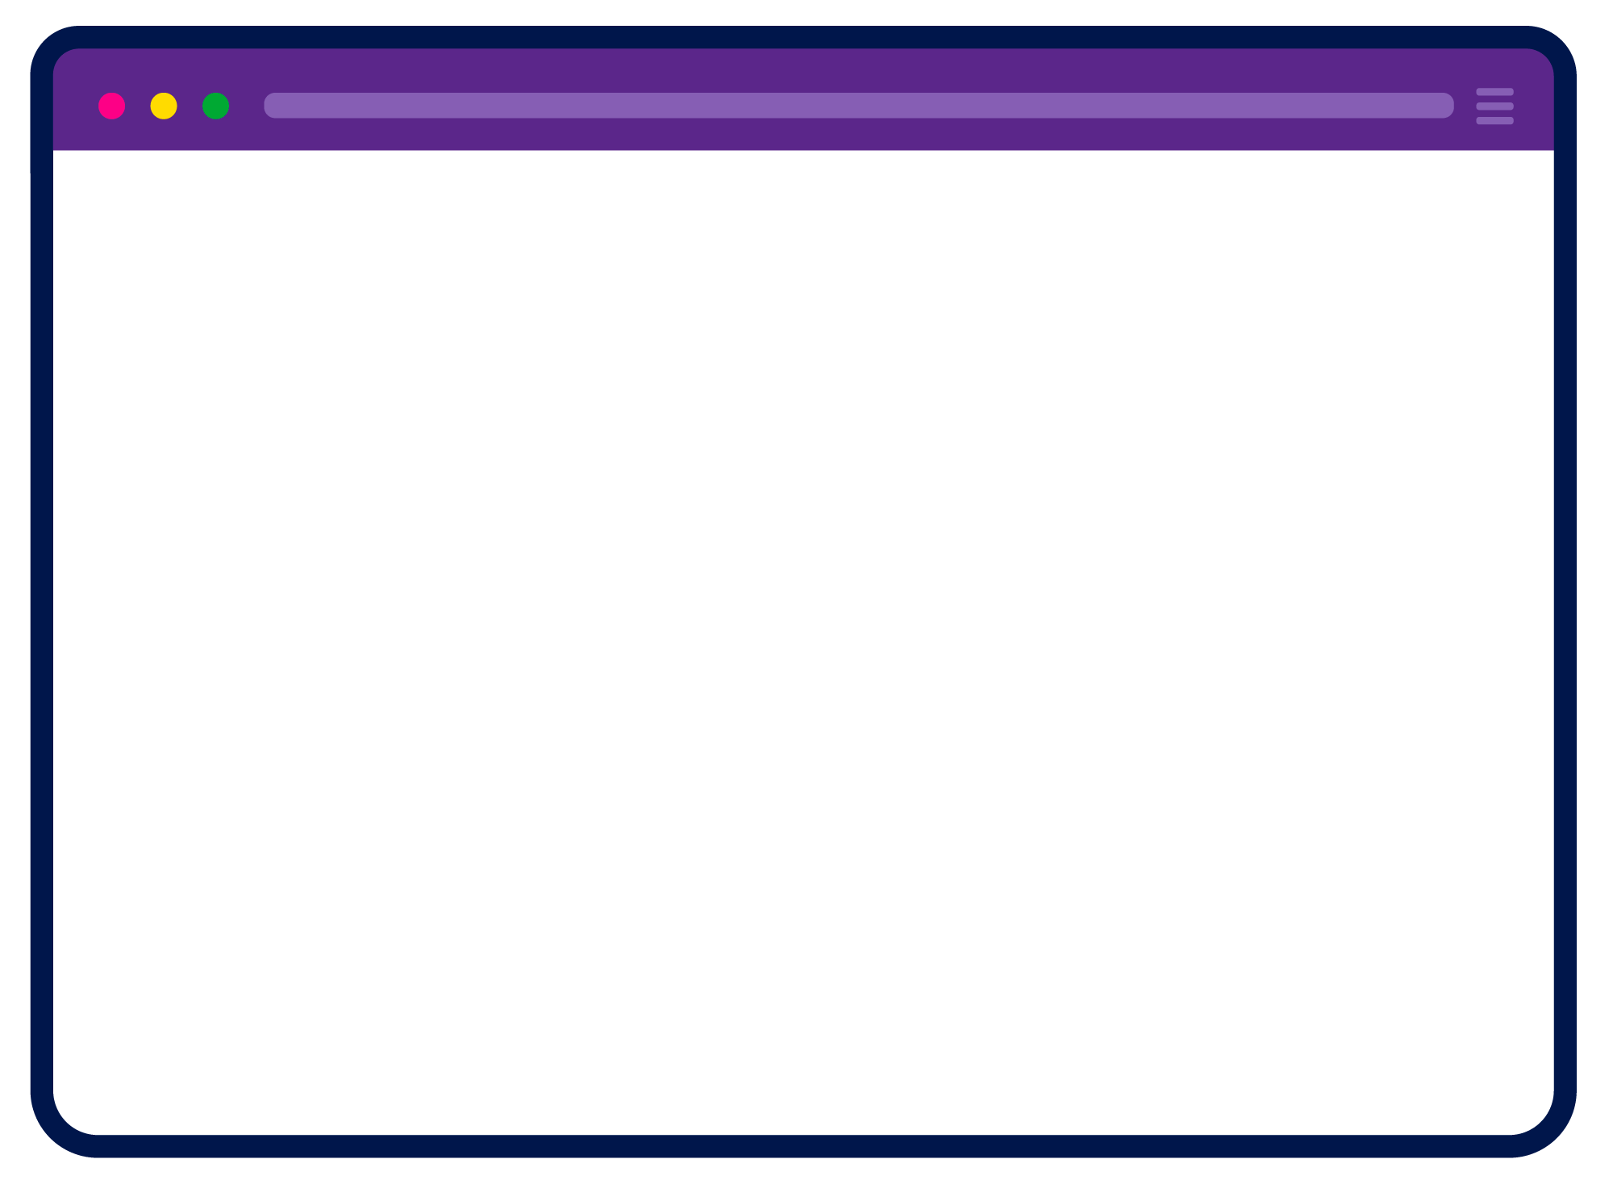
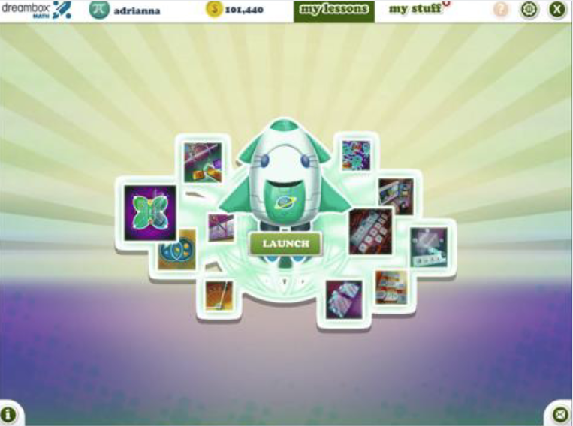
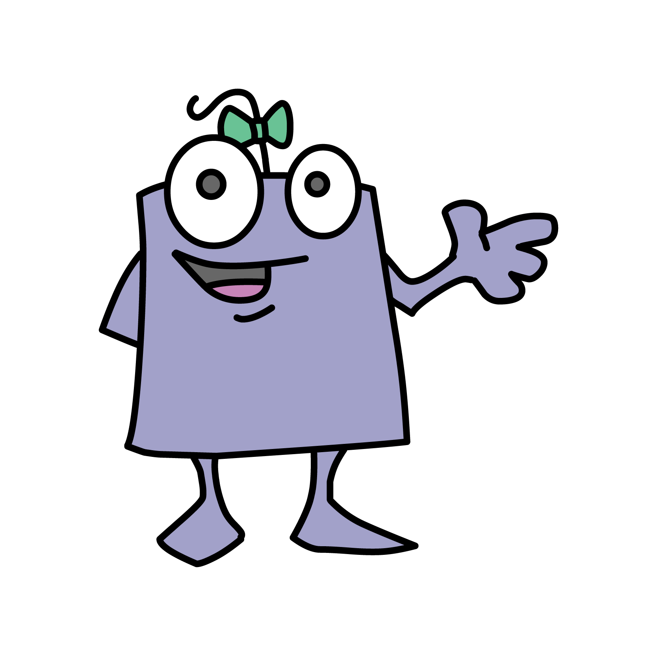
How to start Launchpad
When you log in, your screen will look like this one with a big rocket.
This is Launchpad!
To begin, just click on the rocket.

Slide 4
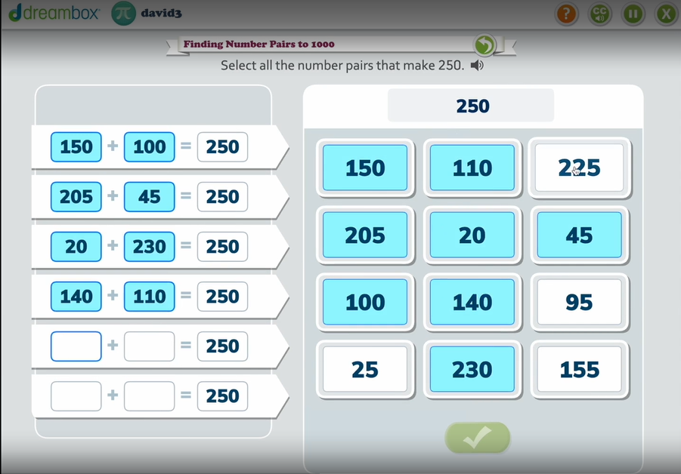
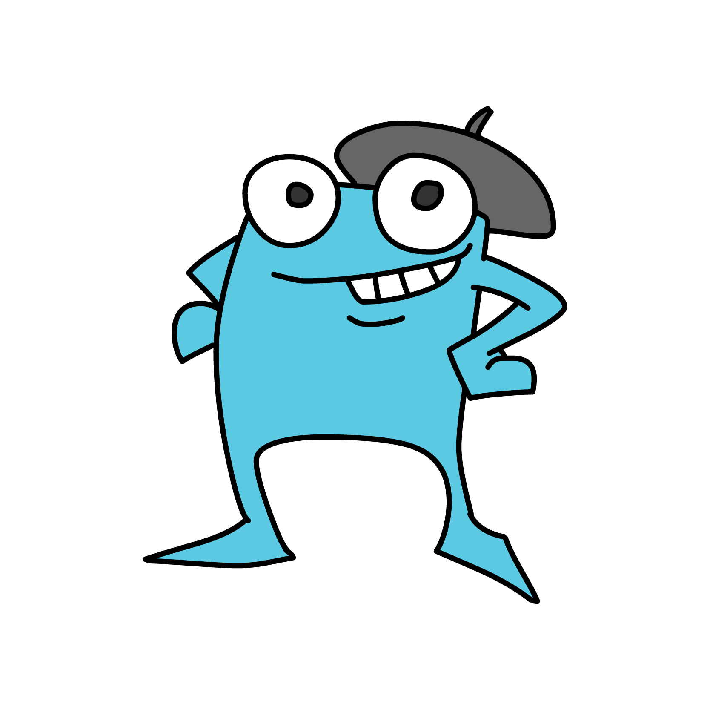
How does it work?
Once you’ve clicked the rocket, you will:
Watch a short video about Launchpad.
Complete the activities and answer the questions.
Take your time – you do not need to rush.
If you don’t finish in your DreamBox Maths session – that’s okay! You can continue when you next log in.

Slide 5
Tips for Launchpad
Don’t give up - even if you find a question too hard Some questions might be too hard and some too easy – this is okay! DreamBox Maths is finding your strengths and areas it can help you grow.
Answer questions on your own
DreamBox Maths needs to know what
you need help with.
Wear headphones
Listen to the questions and support.
Don’t worry about making mistakes because mistakes are an important part of learning.
Notes:
Is ‘experience’ still fine to use?

Slide 6

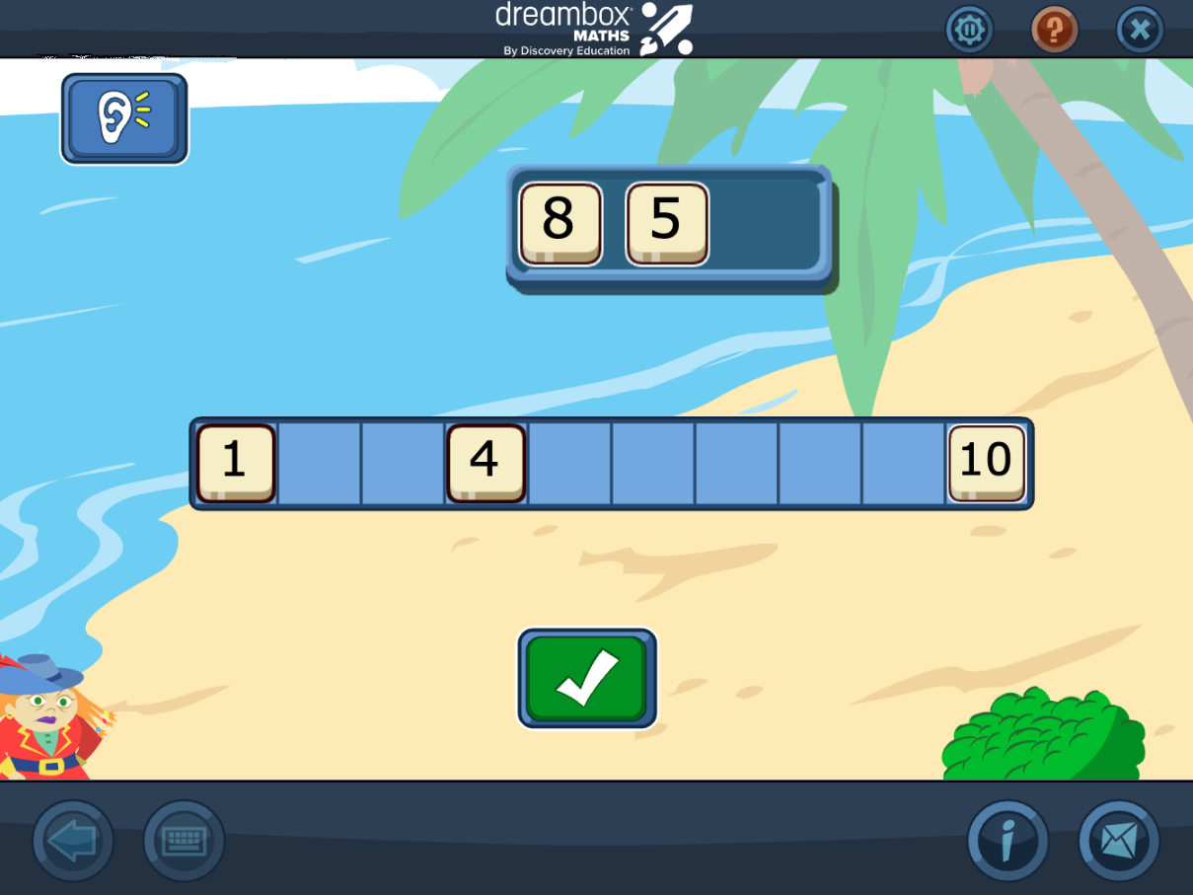
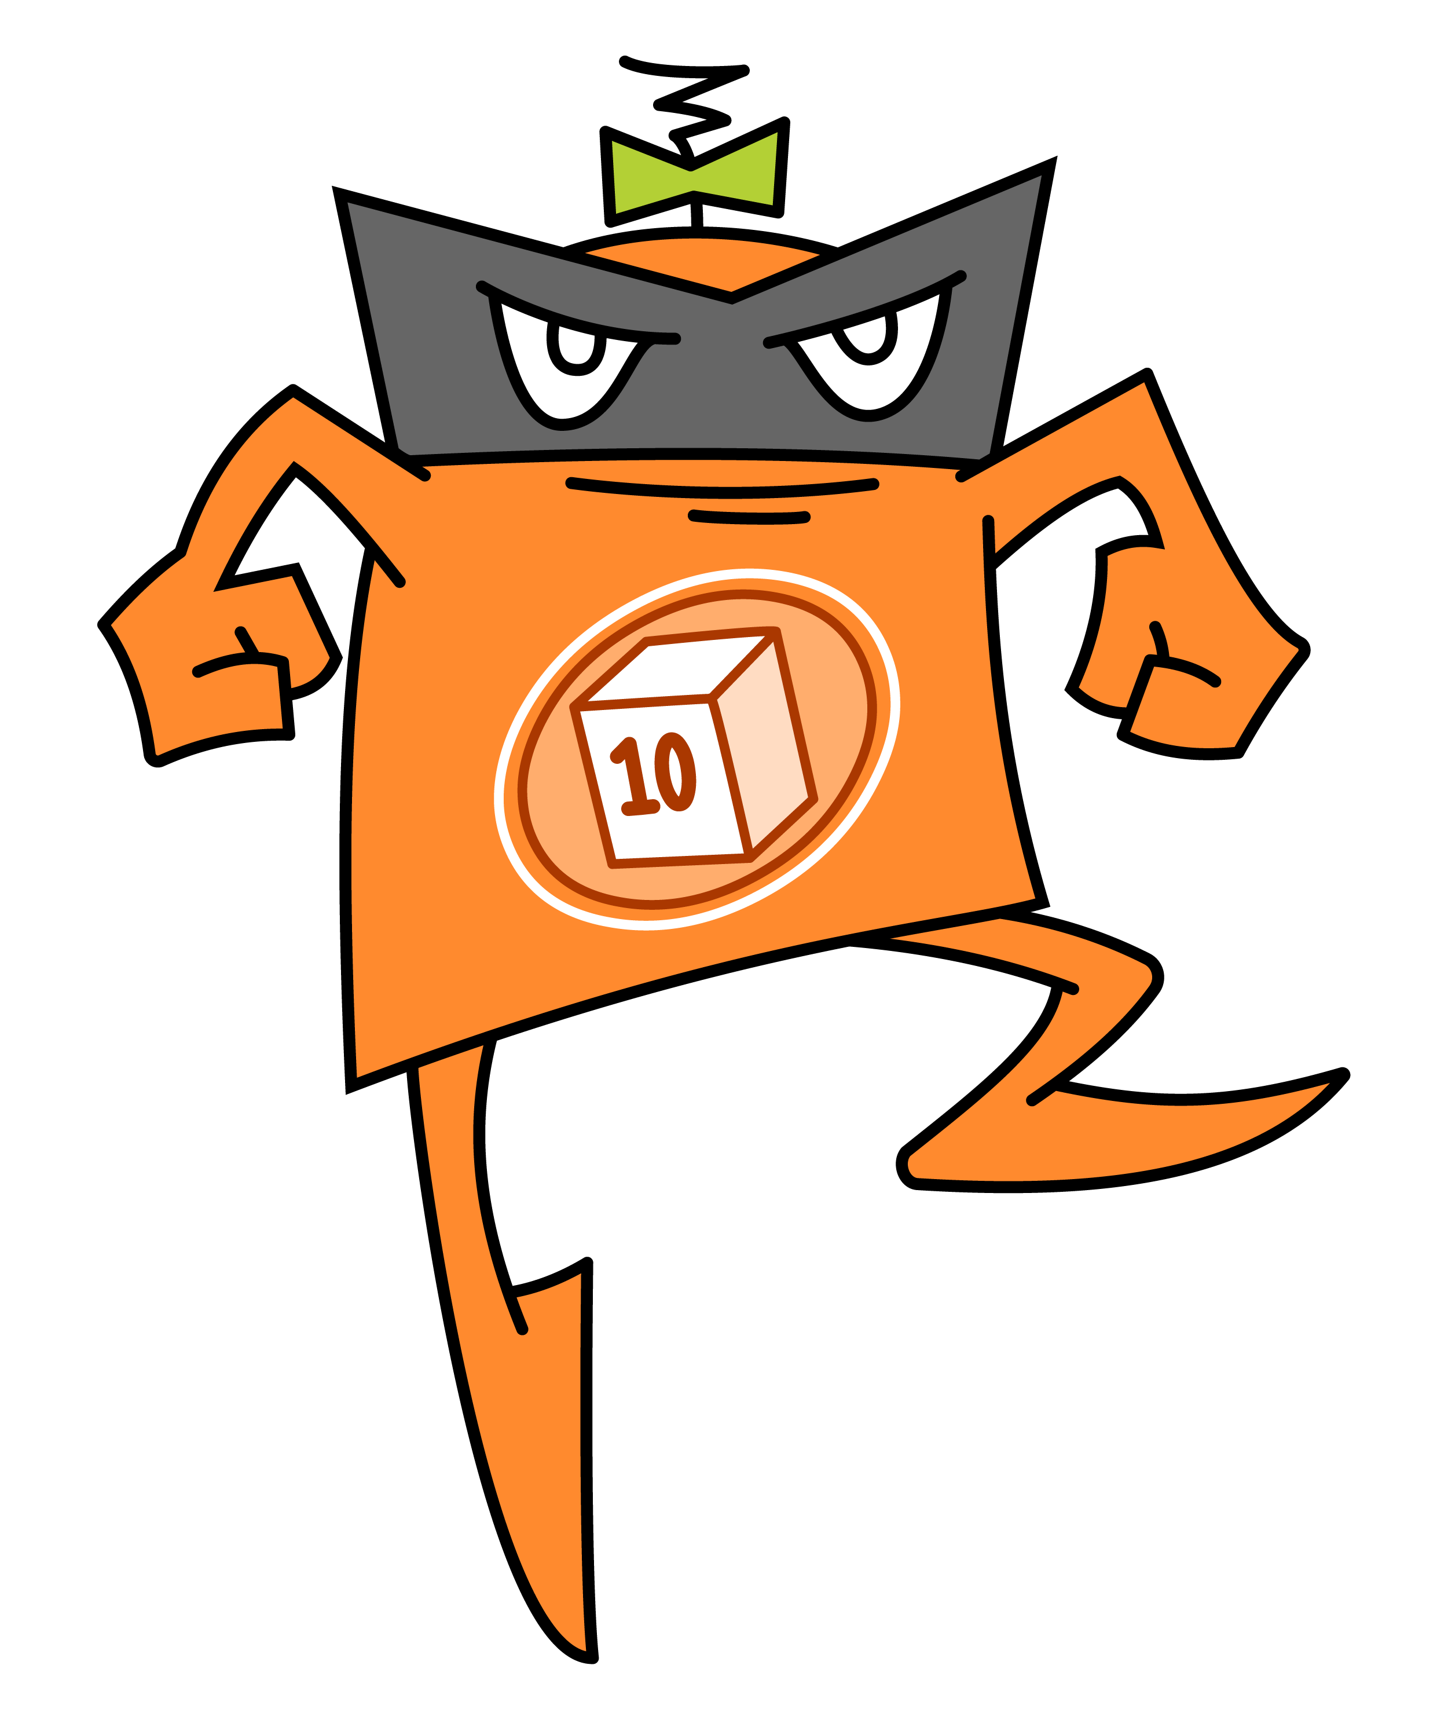
Starting your DreamBox Maths journey
After you have finished Launchpad, you will begin your normal DreamBox Maths lessons.
Enjoy Launchpad, and we can’t wait to see what you achieve on DreamBox Maths!

Slide 7

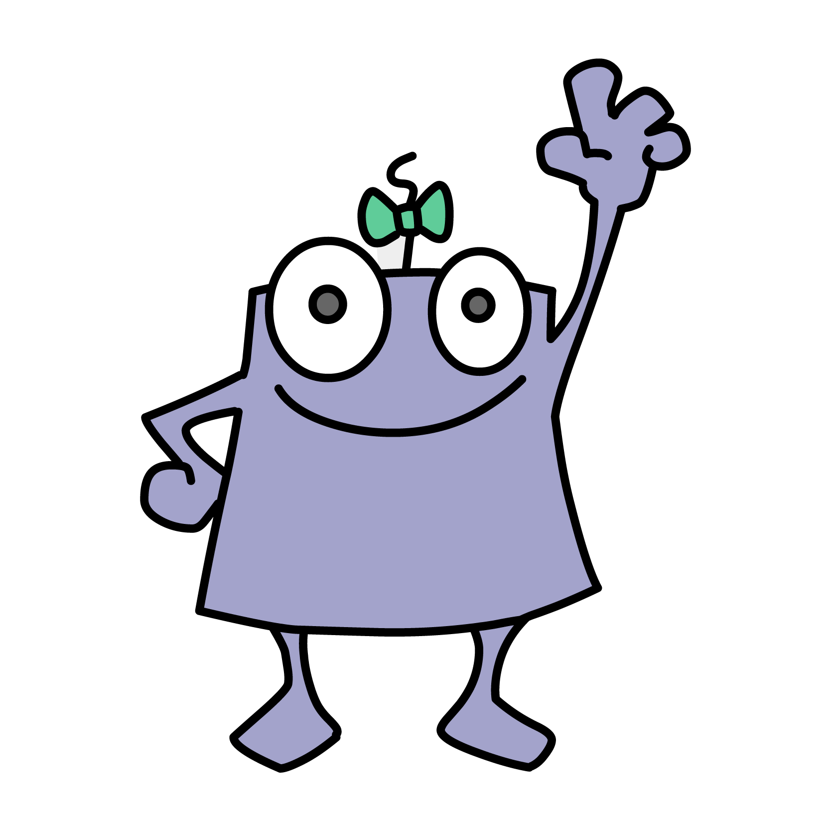
If you have any questions,
ask your teacher
Good luck on your DreamBox Maths journey!

