Slide 1
Introducing Launchpad for DreamBox Maths
For educators

Slide 2

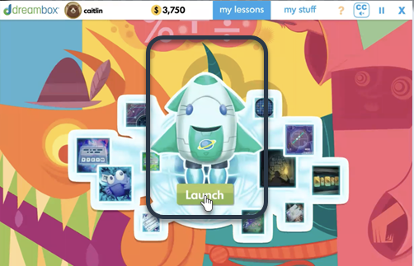

Launchpad at a glance
Launchpad is an in-built placement experience that helps every student start DreamBox Maths at the right level for them.
It does not change how you use DreamBox Maths. It gives the programme an understanding of each student’s maths knowledge from the start, so their personalised learning journey can begin in the right place.

Slide 3
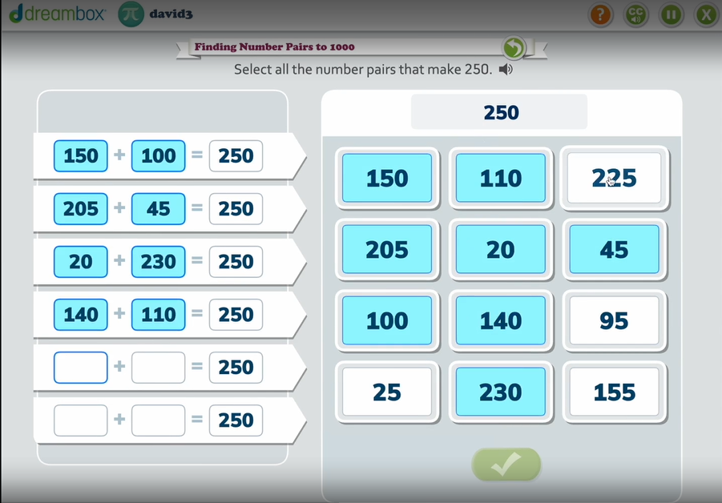
What is Launchpad?
Launchpad is an in-built placement experience within DreamBox Maths.
Students complete a series of interactive maths activities, similar to DreamBox Maths lessons, which help the programme understand their current maths knowledge.
Once complete, DreamBox Maths uses this information to determine an appropriate starting point for each student’s personalised learning journey.
Launchpad is designed for placement, rather than as a test or diagnostic assessment.
Notes:
bit too wordy?

Slide 4
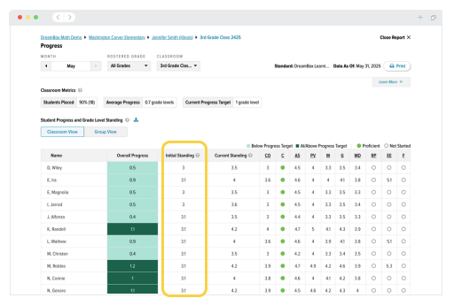
What does this mean for you?
Simple to fit into your maths timetable
Most students complete Launchpad in 15–45 minutes, so it can be completed within a lesson or maths session.
No additional marking or assessment
Launchpad takes place within DreamBox Maths and determines each student’s starting point automatically.
Personalised lessons straight afterwards
Once Launchpad is complete, students can move straight into their personalised DreamBox Maths lessons.
Clearer progress reporting
Launchpad determines each student’s starting point on the Progress Report, giving you a clear point from which to monitor their progress over time. Data updates overnight after students complete Launchpad and one DreamBox Maths lesson.
Notes:
The Launchpad doesn’t sound right there
3rd bullet necessary?

Slide 5
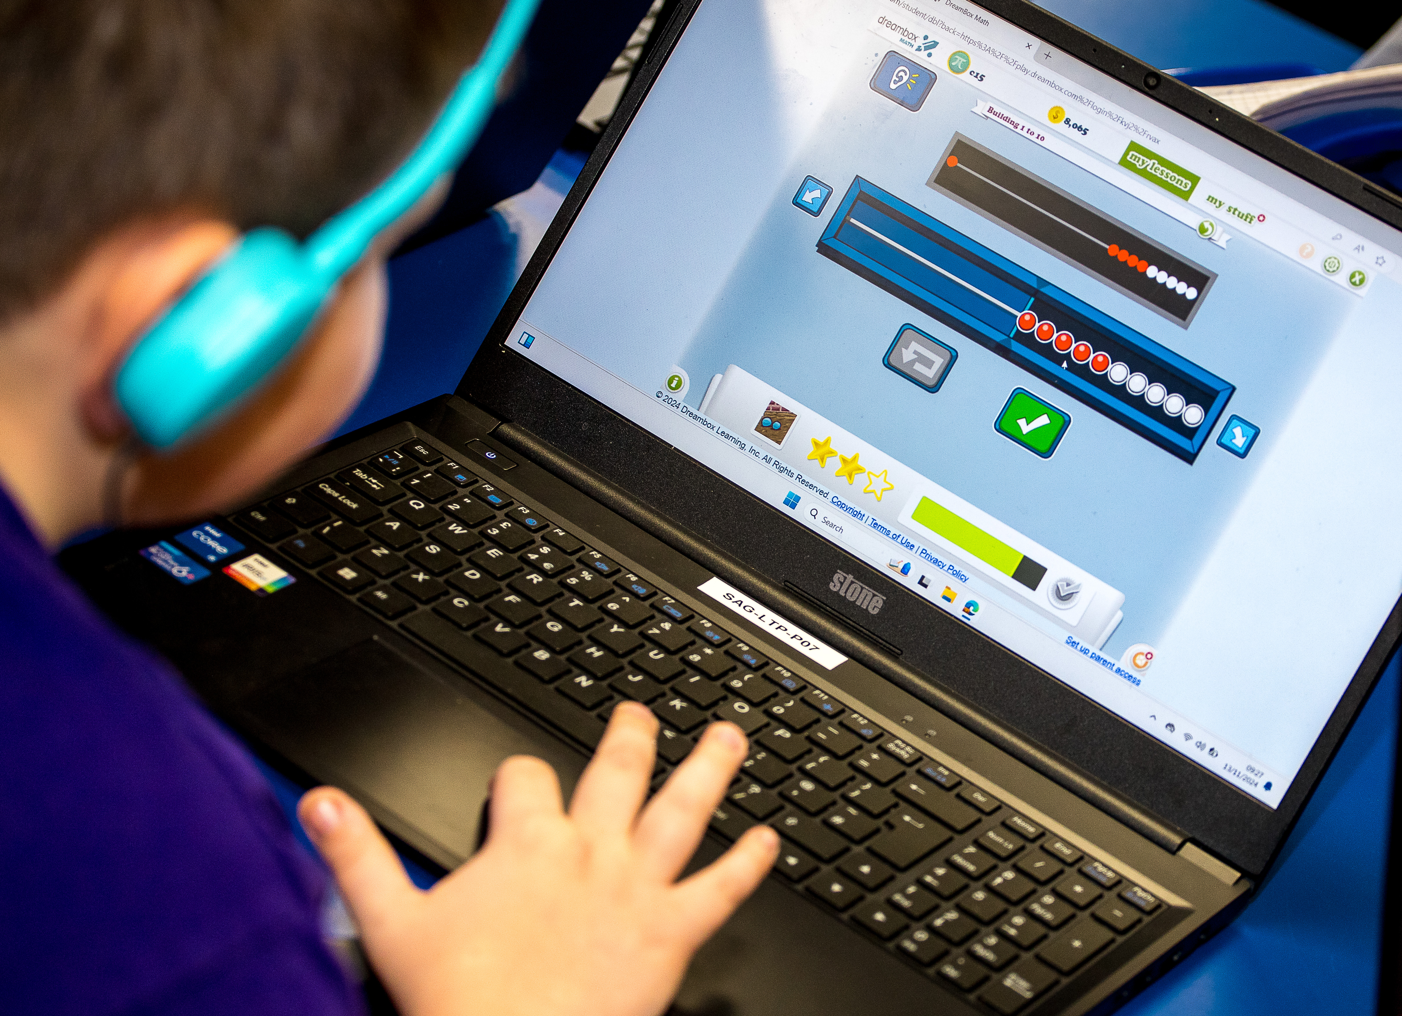
Setting students up correctly
DreamBox Maths still requires each student’s year group placement alongside their student information.
This information supports the set-up of students within DreamBox Maths and helps further hone their Launchpad placement.
If you are unsure whether your student information is up to date, please contact our Customer Success Team.
Notes:
The Launchpad doesn’t sound right there
3rd bullet necessary?

Slide 6
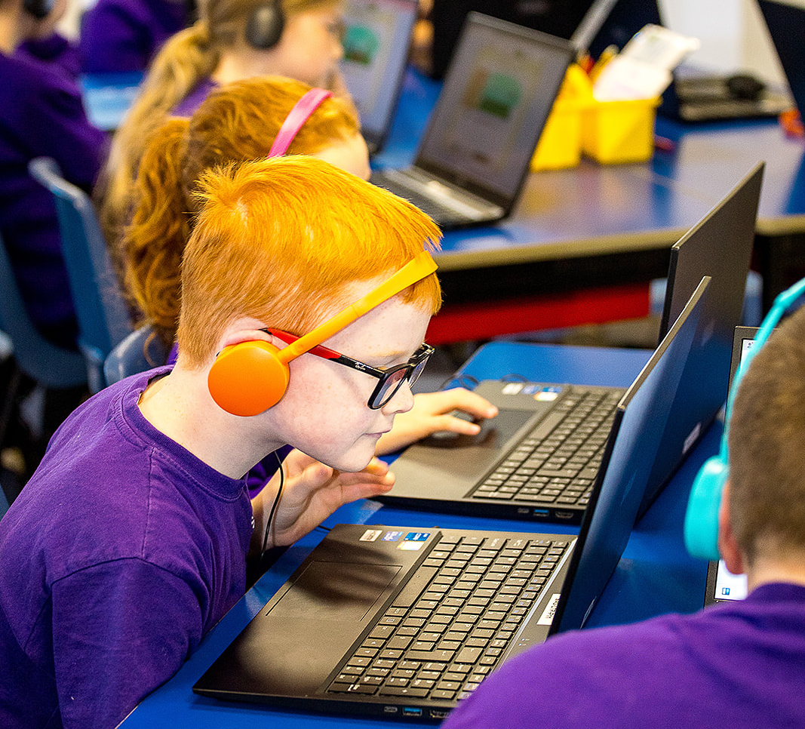
How to run Launchpad
The aim of Launchpad is to understand each student’s maths knowledge so DreamBox Maths can determine an appropriate starting point.
For the most accurate placement, we recommend:
Assign Launchpad during the school day rather than at home.
Ensure students are working independently.
Prepare devices and provide headphones so students can listen to task instructions.
Explain that Launchpad is not a test and students should simply do their best.
Circulate the room while they are completing Launchpad to ensure students are focused and working independently.
Notes:
The Launchpad doesn’t sound right there
3rd bullet necessary?

Slide 7
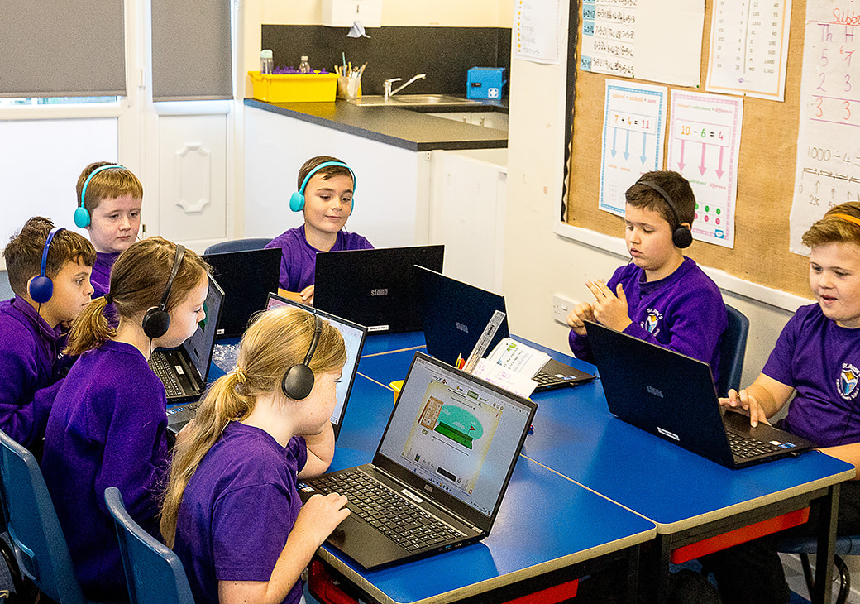
What does this mean for your students?
An engaging activity, not a test
Ensure students understand the goal - this is simply a way for the programme to understand how to best support the student.
Students will complete a series of activities similar to DreamBox Maths lessons, so it won’t feel like a test.
Receive personalised learning faster
It can take 4–6 weeks for the programme to track understanding and ‘learn the learner’ to deliver accurate personalised learning.
With Launchpad, the programme has the information it needs to personalise lessons from the start, creating a more effective and seamless start to each student’s DreamBox Maths journey.

Slide 8
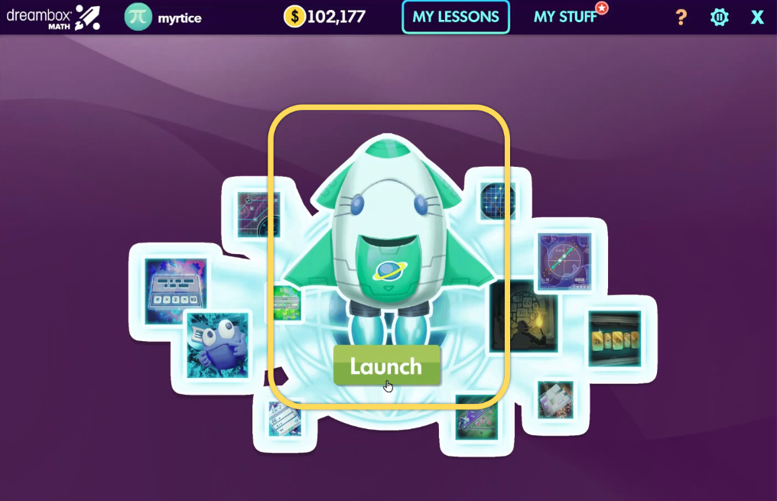
How students complete Launchpad
Log in - Students log in to DreamBox Maths as normal.
Select Launchpad - Students will see the Launchpad rocket in the middle of their screen. Simply click the rocket to begin.
Complete the activities - Most students finish within 15–45 minutes. They can pause and resume without having to start again.
Complete within 30 days - Once started, students have 30 days to complete Launchpad before it resets.
Start personalised learning - Once Launchpad is complete, students can move into their personalised DreamBox Maths lessons.

Slide 9
Need support?
Our Customer Success Team is on hand to support you with Launchpad.
Contact our team on 0191 389 6078 or mathssupport@daisyeducationuk.com
Please contact us if:
A student needs to be opted out of Launchpad
A student accidentally starts Launchpad and needs to restart
You would like a previously opted out student to complete Launchpad
A student has completed Launchpad but their placement does not look right
A student received help while completing Launchpad and their placement may need reviewing

Slide 10


