Slide 1
Introducing Launchpad
For UKS2/KS3 students

Slide 2
What is Launchpad?
You will complete Launchpad at the beginning of your DreamBox Maths learning journey.
It will:
Be similar to a normal DreamBox Maths lesson – but have more questions covering a larger range of topics.
Take longer than a normal DreamBox Maths lesson - and can take anywhere from 15 to 45 minutes.
Have a range of questions that might be too difficult or too easy – this is okay! DreamBox Maths is finding out how you tackle maths problems to find your strengths and spot areas it can help you develop.
It will not:
Be a test or give you a score.
It is simply for DreamBox Maths to discover what you already know in maths, and what lessons it needs to give you to help you progress.

Slide 3
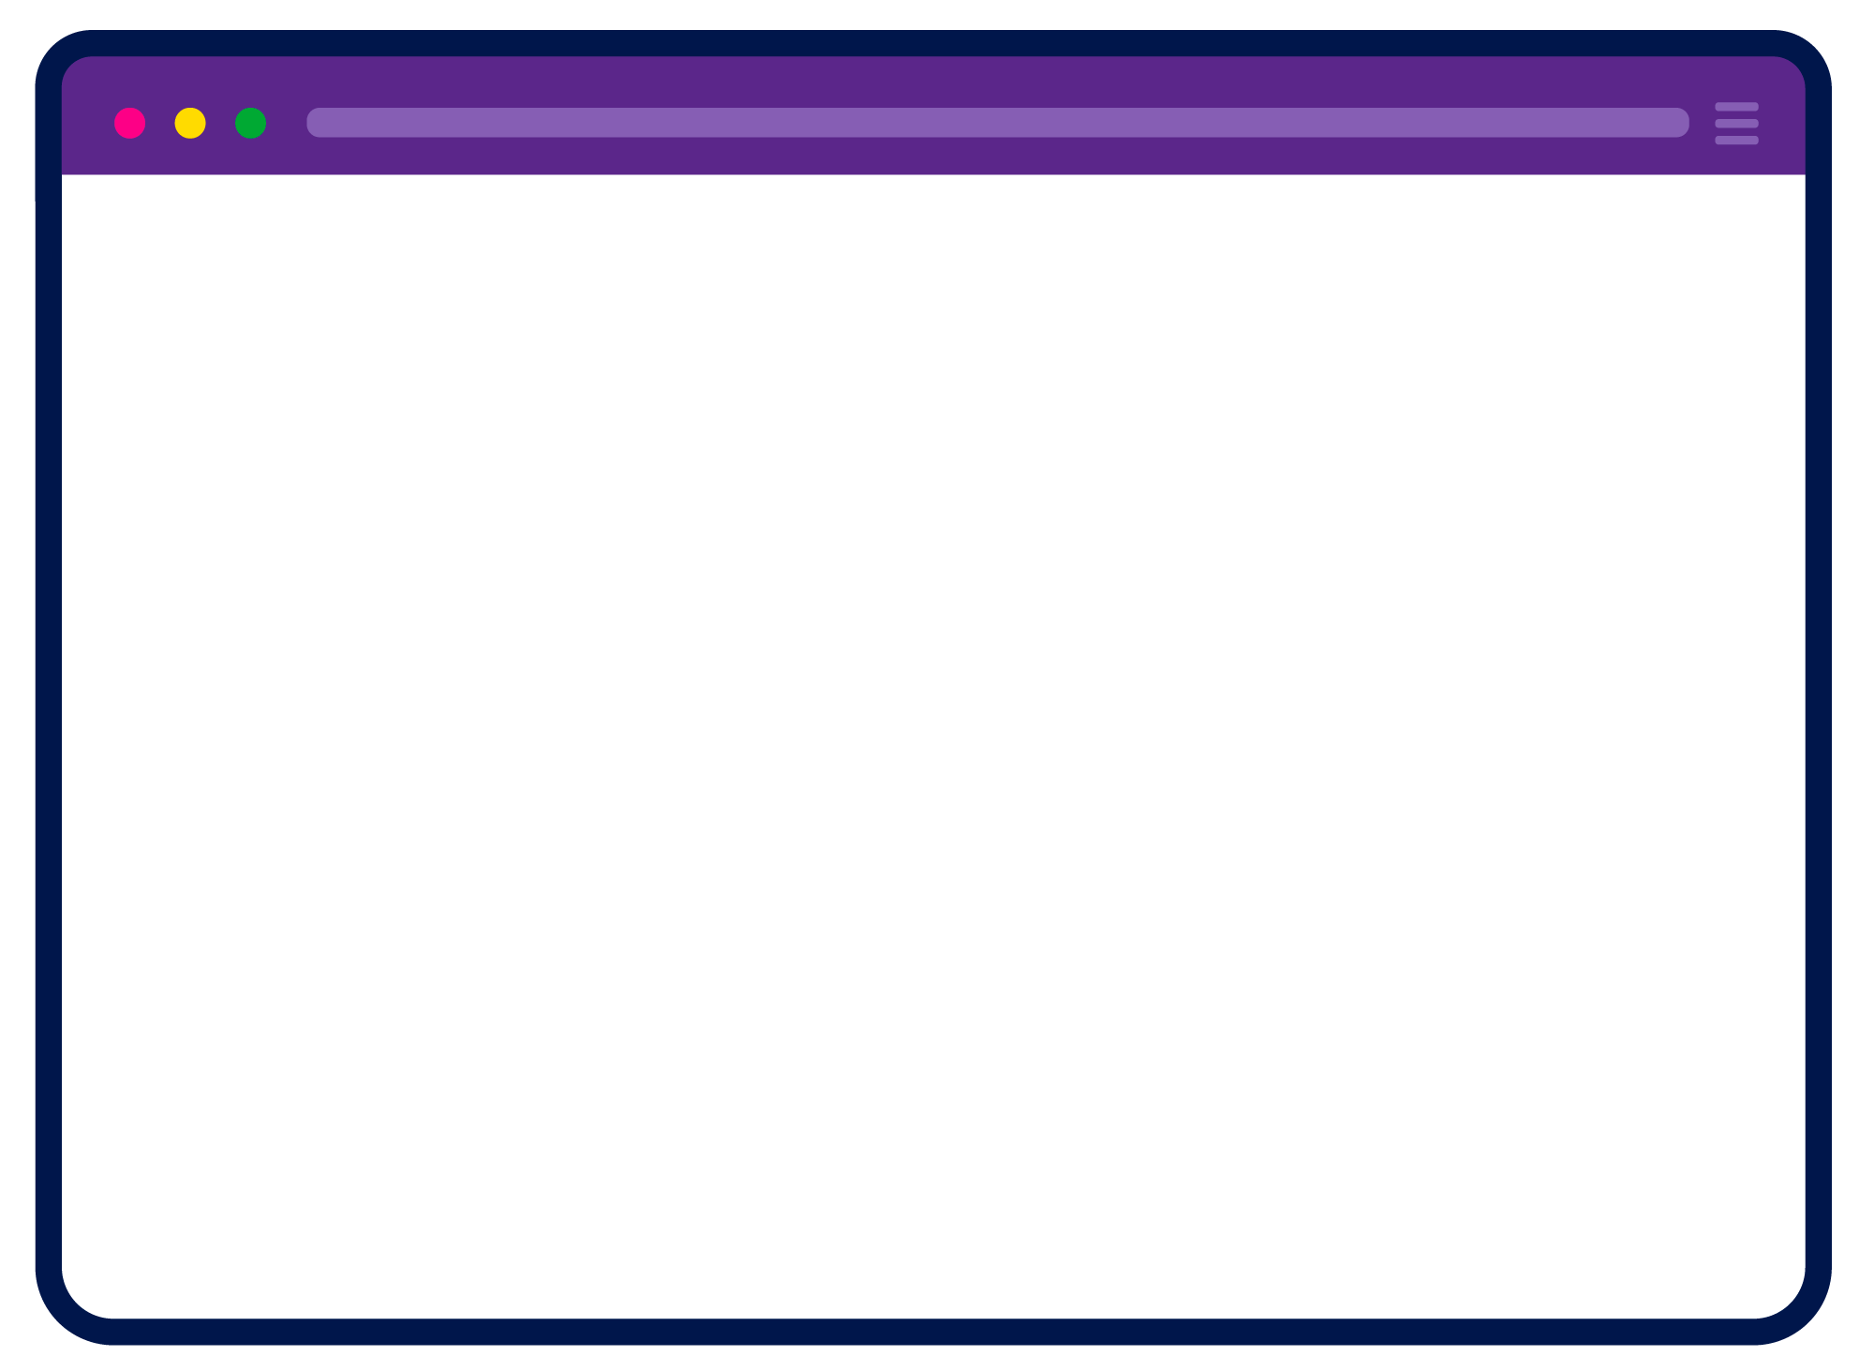
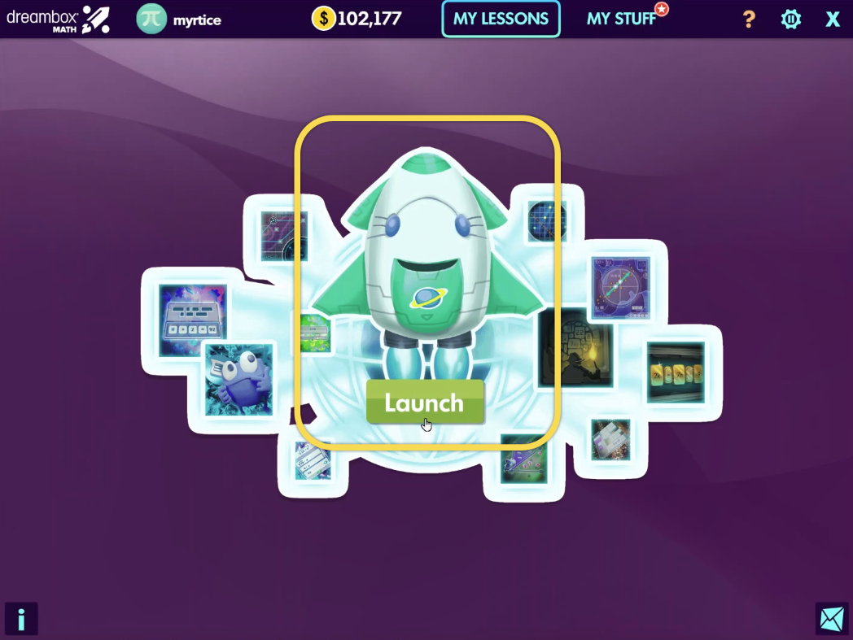
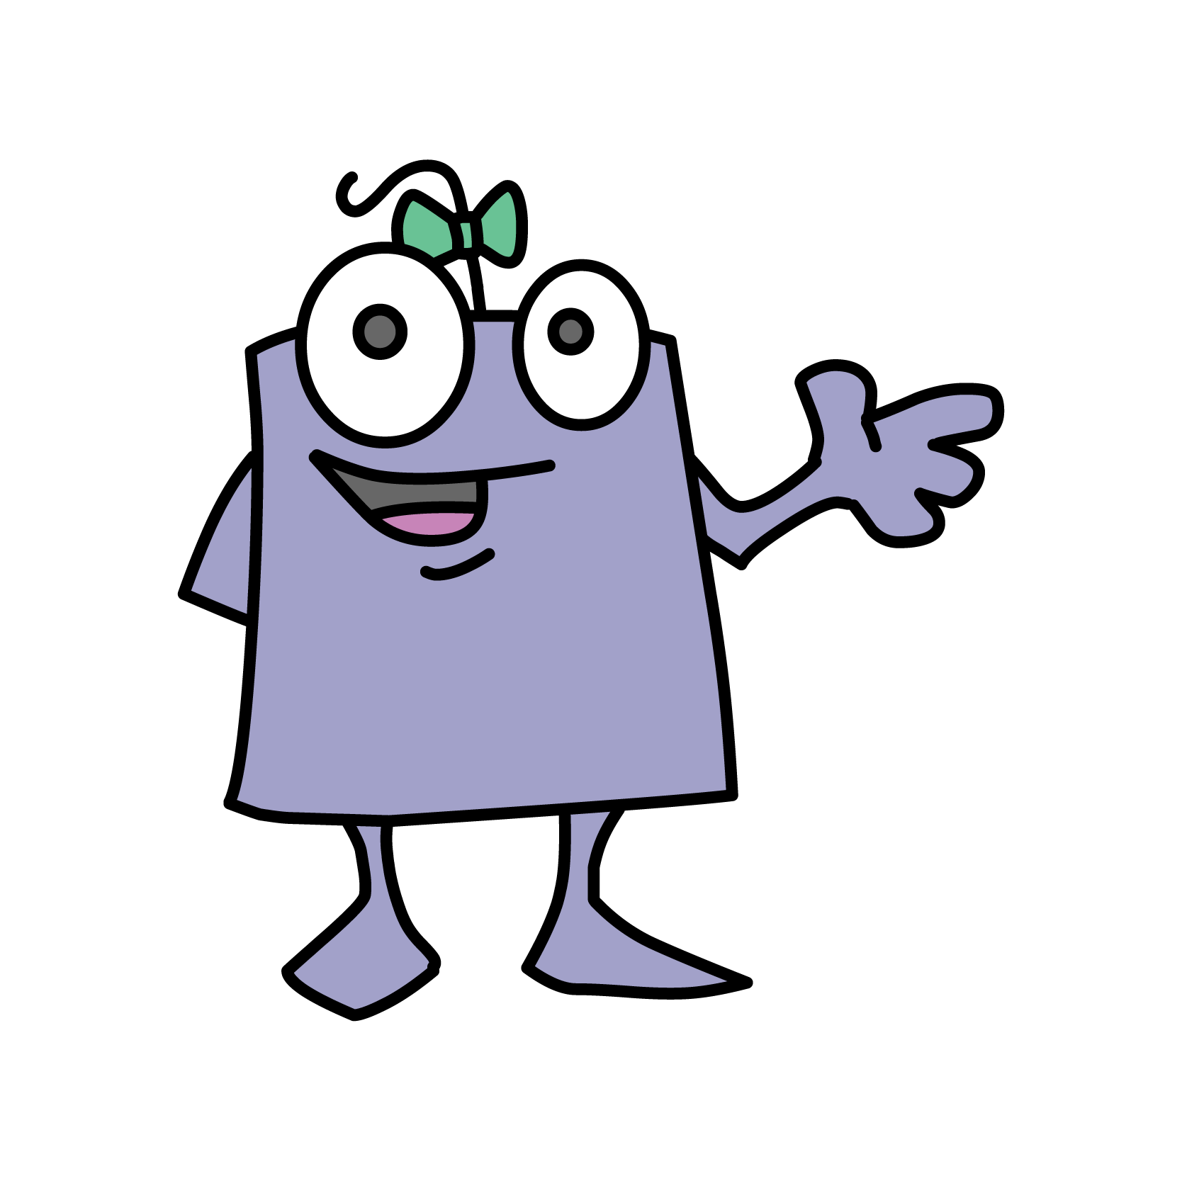
How does Launchpad work?
When you first log in, you will see the Launchpad rocket. Click it to begin.
Watch the short video explaining how to complete Launchpad.
Answer the questions independently.

Slide 4
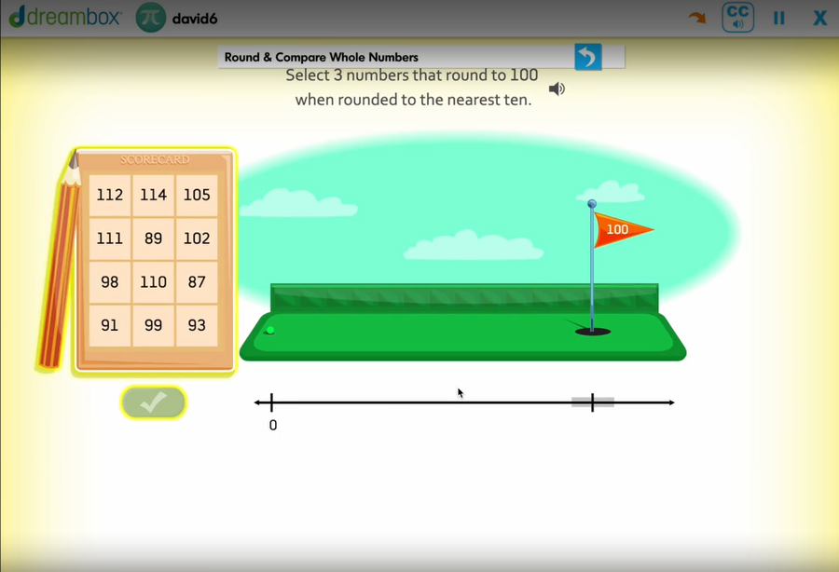
How does Launchpad work?
Take your time– it is not timed so you do not need to rush.
If you don’t finish in your DreamBox Maths session – that’s okay! You can continue when you next log in.

Slide 5
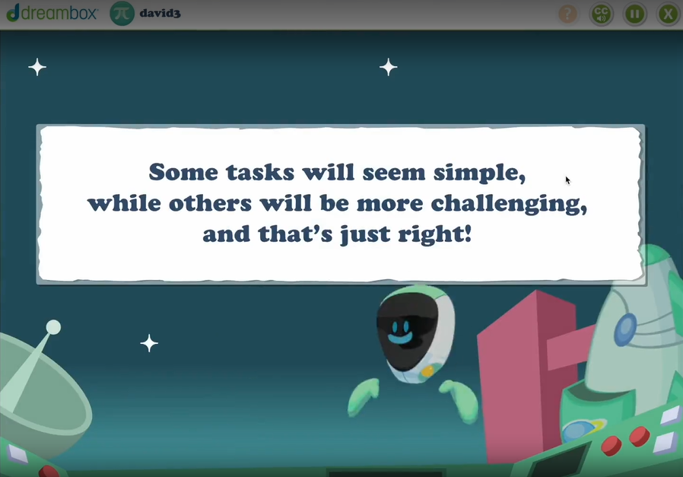
Tips for Launchpad
Wear headphones
Listen to the questions and support.
Answer questions independently
It is important that Launchpad understands your maths abilities so it can help you grow.
If you are helped to get answers correct, the programme will think this is the right level for you, and give you lessons that are too hard.
Notes:
Is ‘experience’ still fine to use?

Slide 6
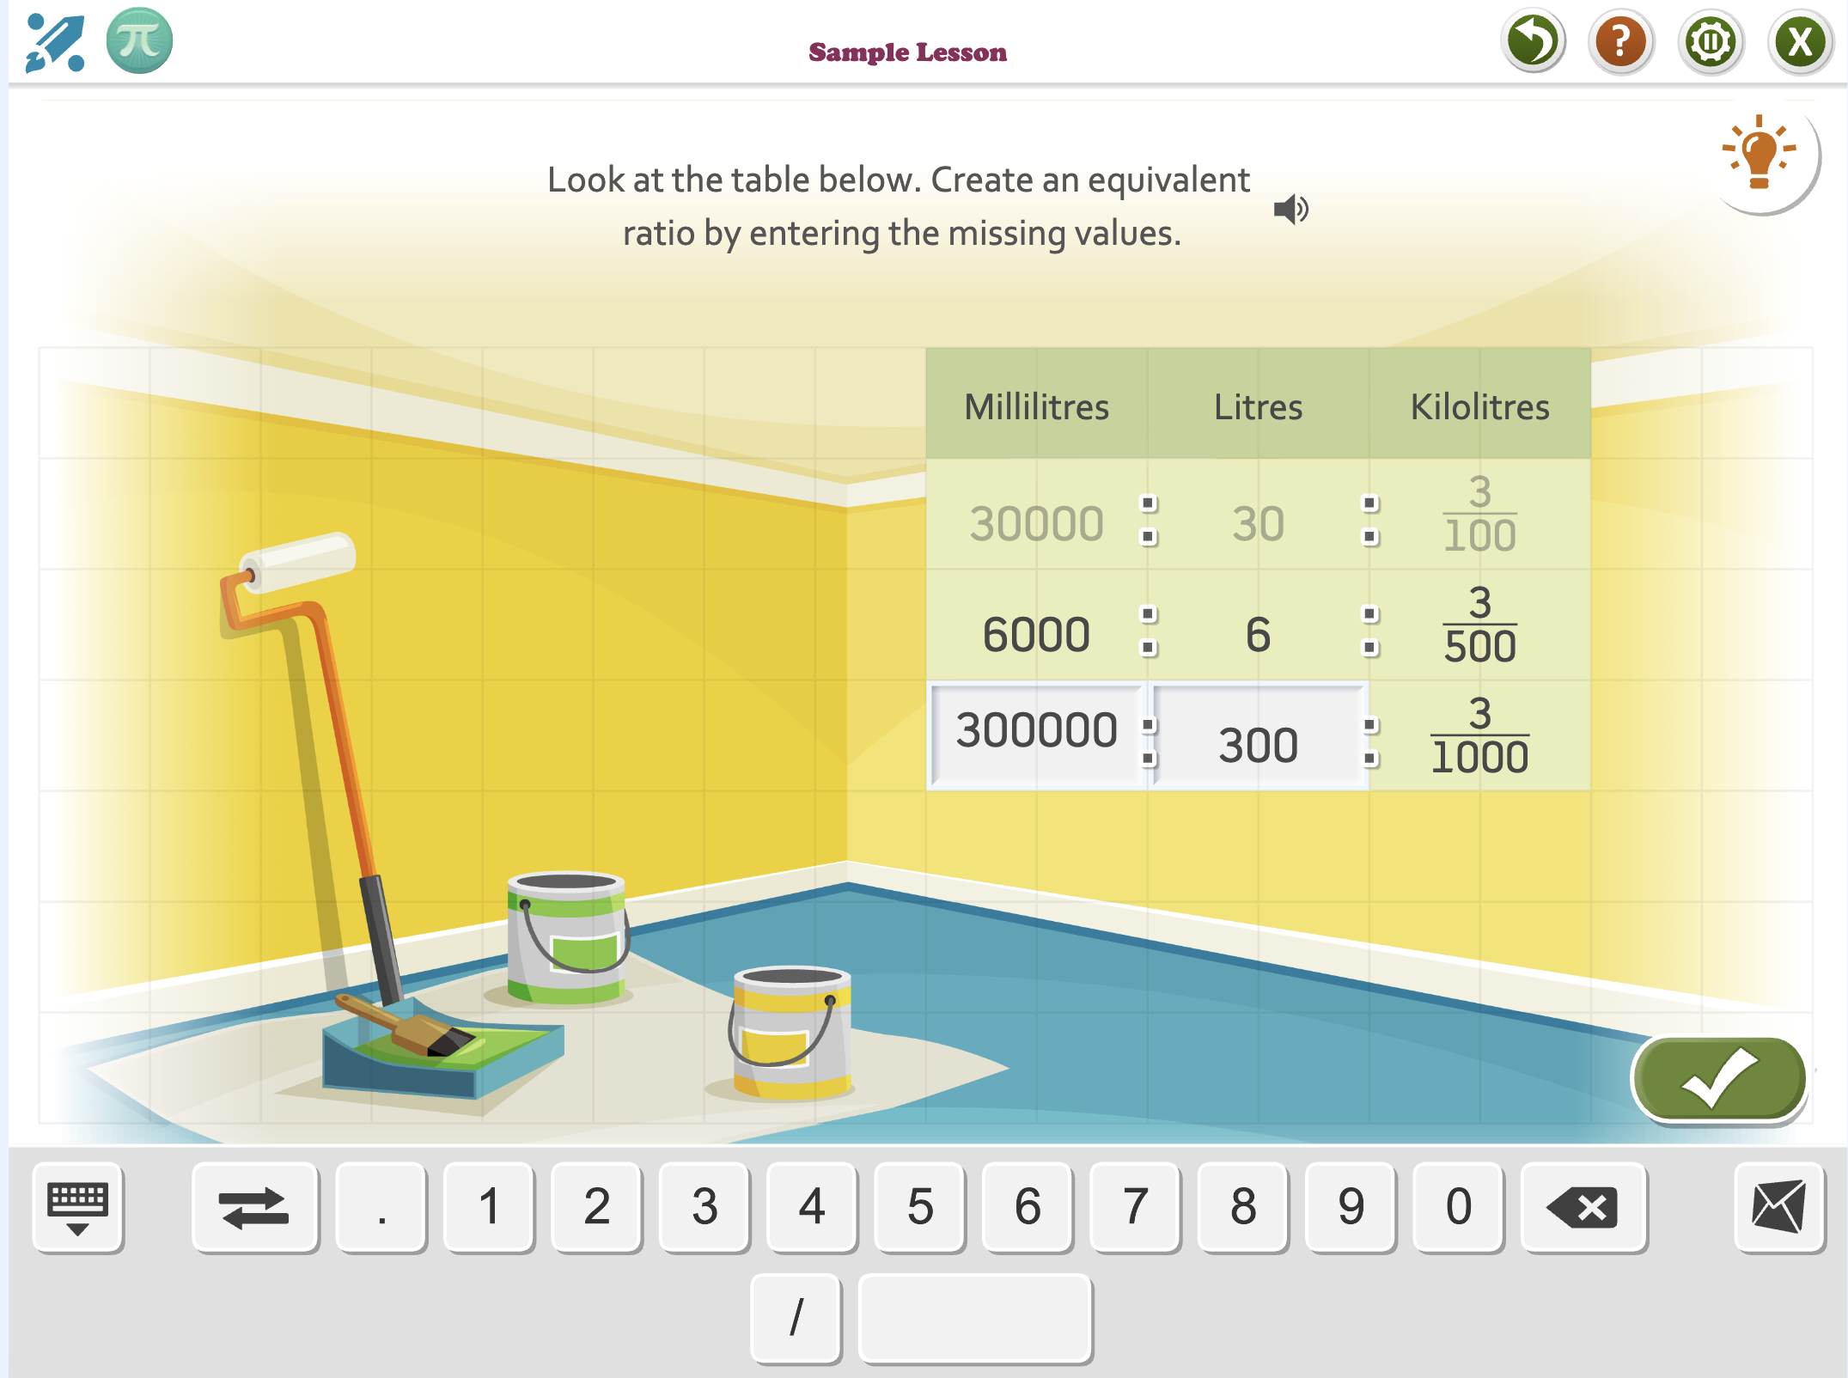
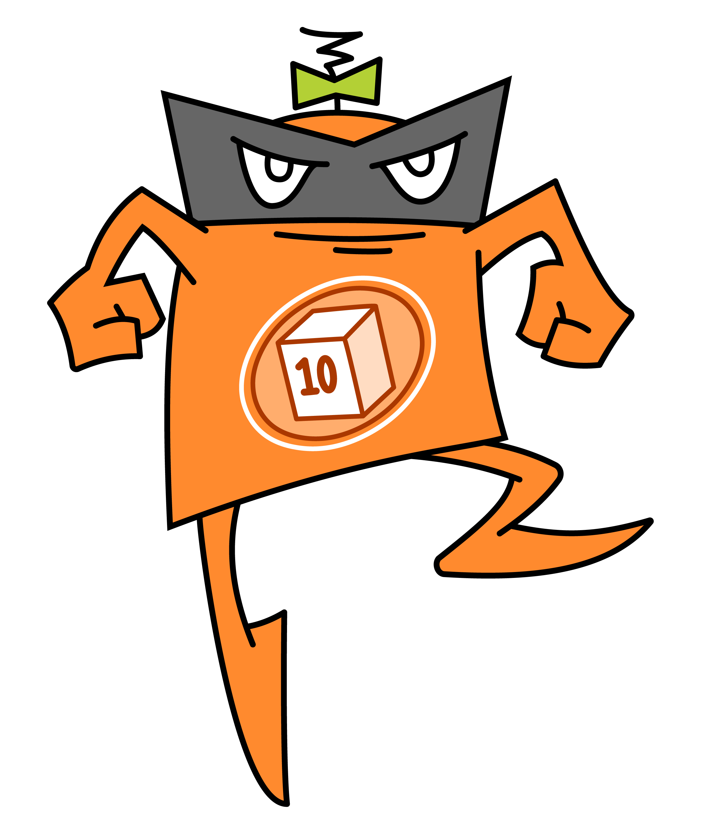
Starting your DreamBox Maths journey
Once Launchpad is completed, you will continue with your DreamBox Maths lessons as normal.
Enjoy Launchpad, and we can’t wait to see what you achieve on DreamBox Maths!

Slide 7

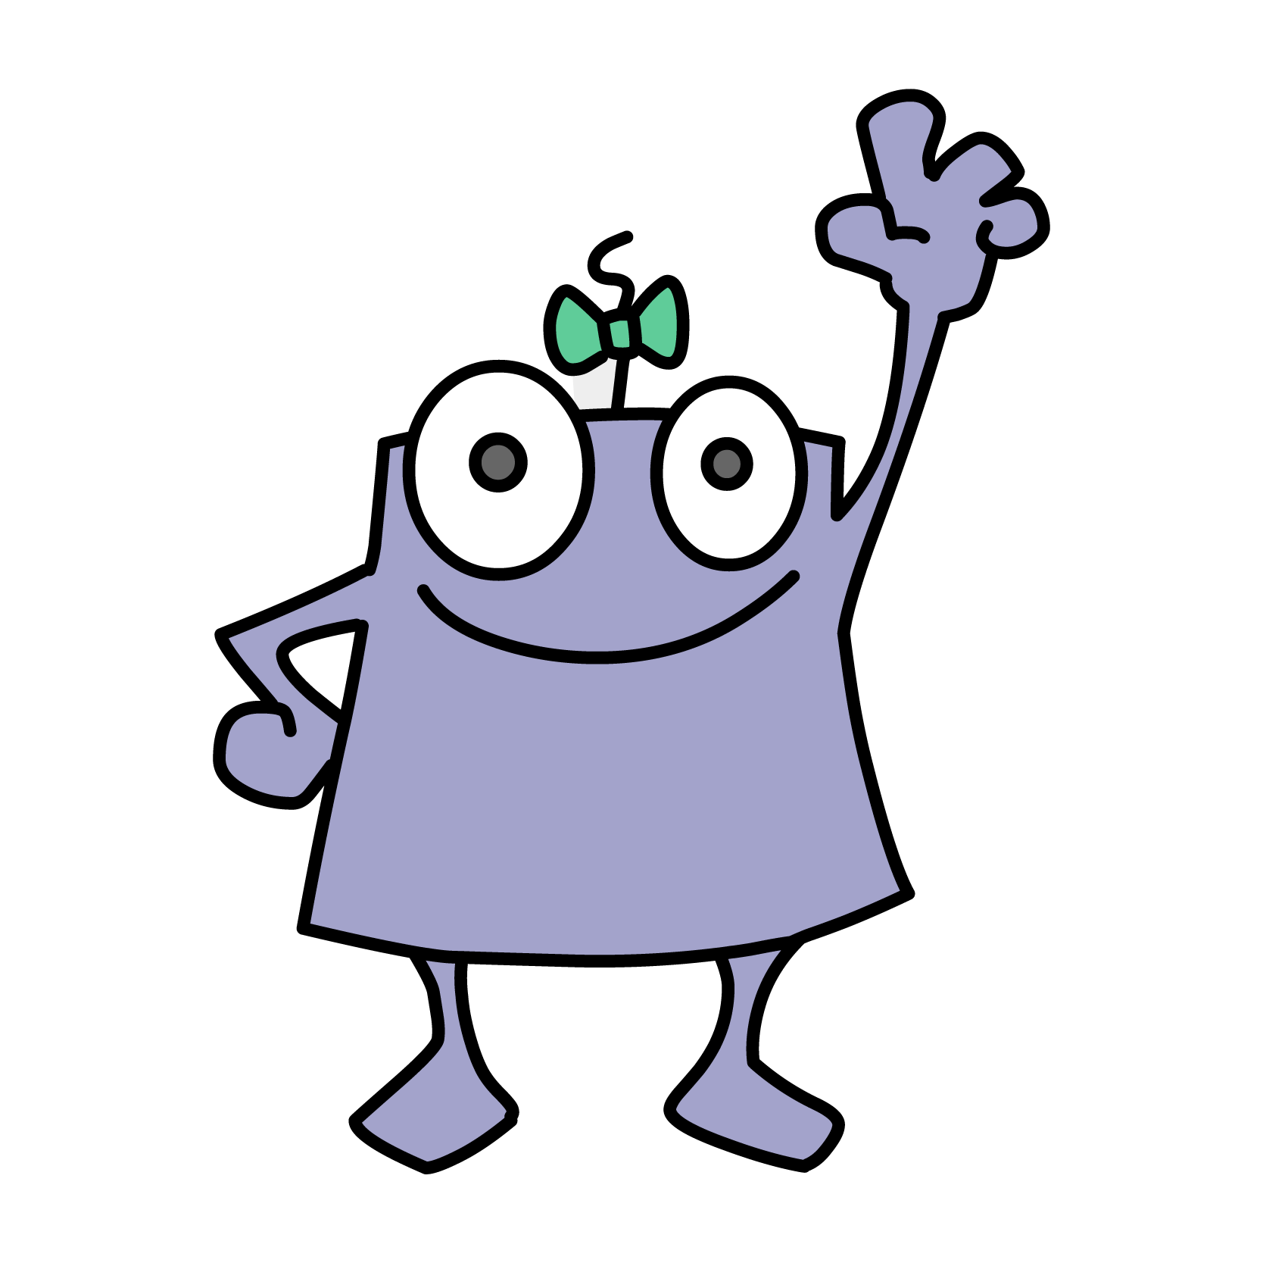
Questions?

